Slide 1
OTHER COMBINATIONAL LOGIC CIRCUITS
WEEK 12
DECODERS
ENCODERS

Slide 2
DECODER
A decoder is a logic circuit that accepts a set of inputs that represents a binary number and activates only the output that corresponds to the input number.
In other words, a decoder circuit looks at its inputs, determines which binary number is present there, and activates the one output that corresponds to that number; all other outputs remain inactive

Slide 3
In its general form, a decoder has N input lines to handle N bits and form one to 2^{N} output lines to indicate the presence of one or more N-bit combinations.
The basic binary function
An AND gate can be used as the basic decoding element because it produces a HIGH output only when all inputs are HIGH
Refer next slide for example

Slide 4
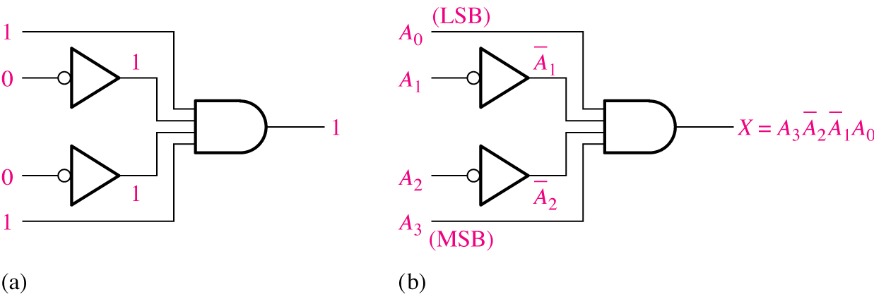
Decoding logic for the binary code 1001 with an active-HIGH output.

Slide 5
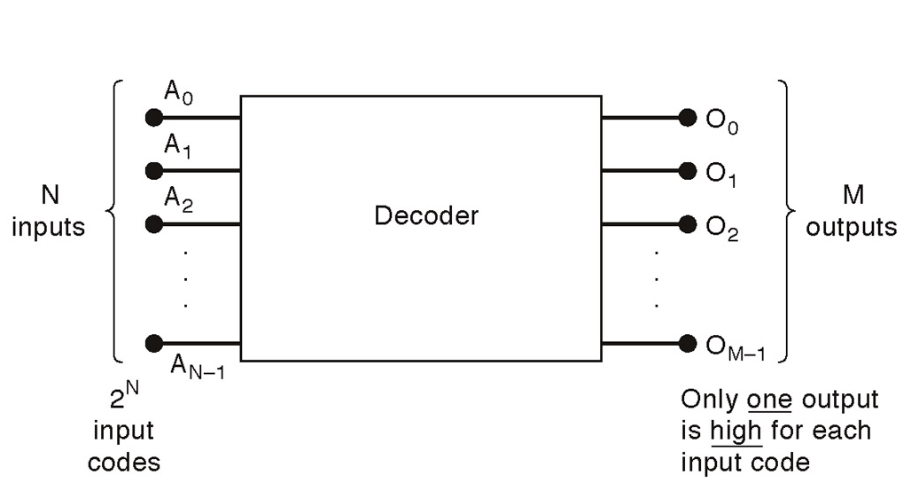
General decoder diagram
# There are 2^{N} possible input combinations, from A₀ to A_{N−1}.
For each of these input combinations only one of the M outputs will be active HIGH (1), all the other outputs are LOW (0).

Slide 6
If an active-LOW output (74138, one of the output will low and the rest will be high) is required for each decoded number, the entire decoder can be implemented with
    NAND gates
    Inverters
If an active-HIGH output (74139, one of the output will high and the rest will be low) is required for each decoded number, the entire decoder can be implemented with
    AND gates
    Inverters

Slide 7
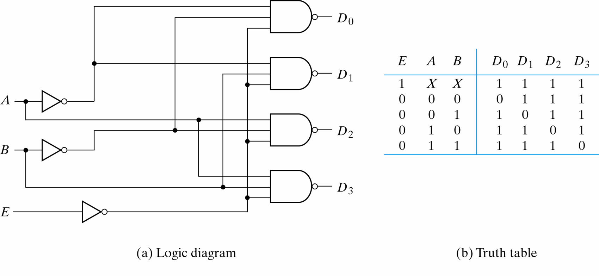
2-to-4-Line Decoder
(with Enable input)-Active LOW output (1)...

Slide 8
2-to-4-Line Decoder
(with Enable input)-Active LOW output (2)
The circuit operates with complemented outputs and a complement enable input. The decoder is enabled when E is equal to 0.
Only one output can be equal to 0 at any given time, all other outputs are equal to 1.
The output whose value is equal to 0 represents the minterm selected by inputs A and B
The circuit is disabled when E is equal to 1.

Slide 9
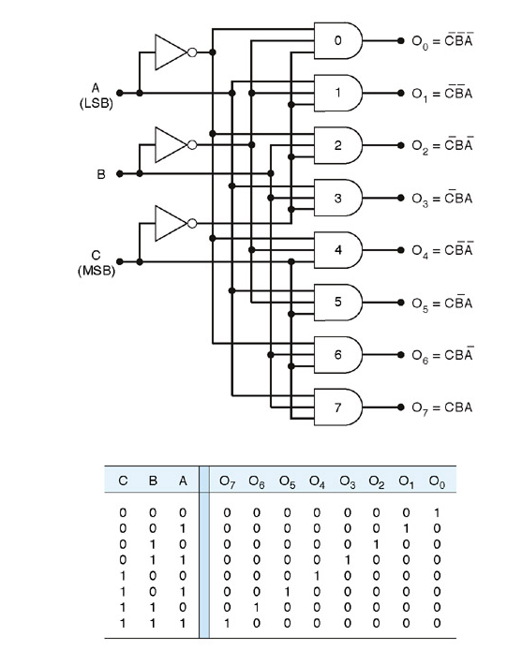
3-8 line decoder (active-HIGH)

Slide 10
This decoder can be referred to in several ways. It can be called a 3-line-to- 8-line decoder, because it has three input lines and eight output lines.
It could also be called a binary-octal decoder or converters because it takes a three bit binary input code and activates the one of the eight outputs corresponding to that code. It is also referred to as a 1-of-8 decoder, because only 1 of the 8 outputs is activated at one time.

Slide 11
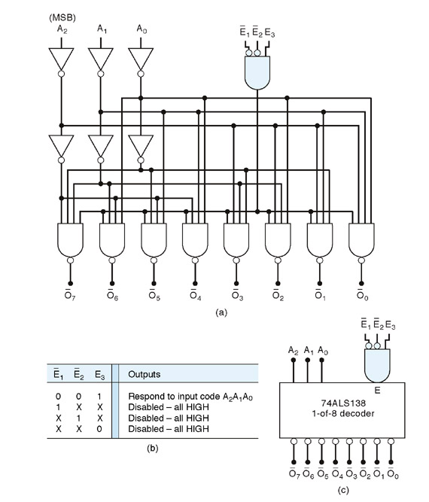
Logic diagram of 74138 (Example of a 3−Bit Decoder)

Slide 12
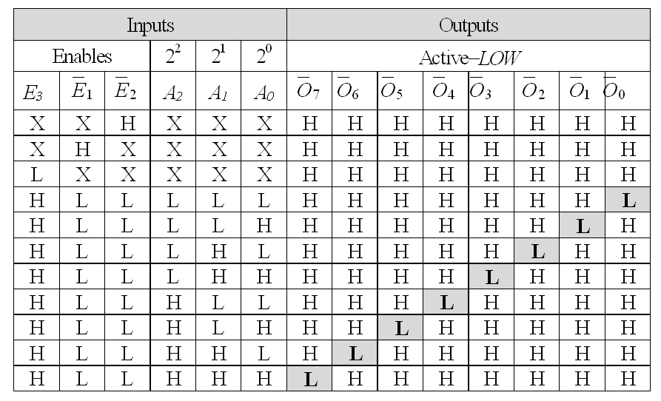
Truth table of 74138 (Example of a 3− 8 Bit Decoder) active-LOW

Slide 13
74138 (Example of a 3− 8 Bit Decoder)
There is an enable function on this device, a LOW level on each input E’₁, and E’₂, and a HIGH level on input E₃, is required in order to make the enable gate output HIGH.
The enable is connected to an input of each NAND gate in the decoder, so it must be HIGH for the NAND gate to be enabled.
If the enable gate is not activated then all eight decoder outputs will be HIGH regardless of the states of the three input variables A₀, A₁, and A₂ .

Slide 14
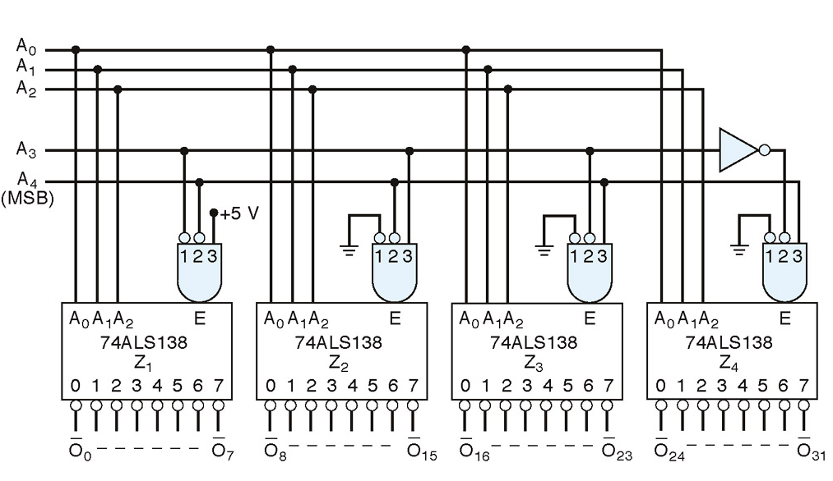
Example of a 5 to 32 Bit Decoder

Slide 15
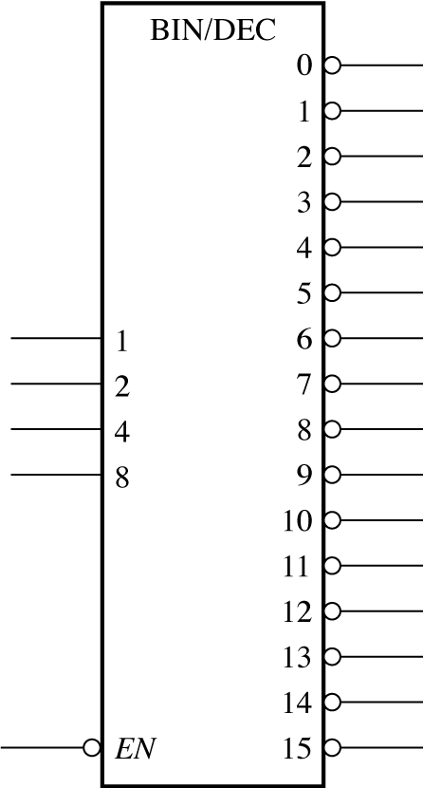
Logic symbol for a 4-line-to-16-line (1-of-16) decoder . 74HC154

Slide 16
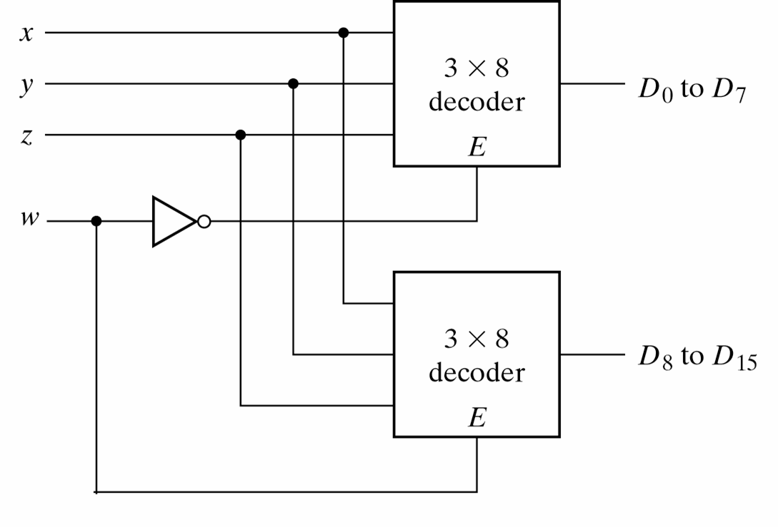
4-line-to-16 line Decoder constructed with two 3-line-to-8 line Decoders

Slide 17
4-line-to-16 line Decoder constructed with two 3-line-to-8 line Decoders
When w=0, the top decoder is enabled and the other is disabled. The bottom decoder outputs are all 0’s , and the top eight outputs generate min-terms 0000 to 0111.
When w=1, the enable conditions are reversed. The bottom decoder outputs generate min-terms 1000 to 1111, while the outputs of the top decoder are all 0’s.

Slide 18
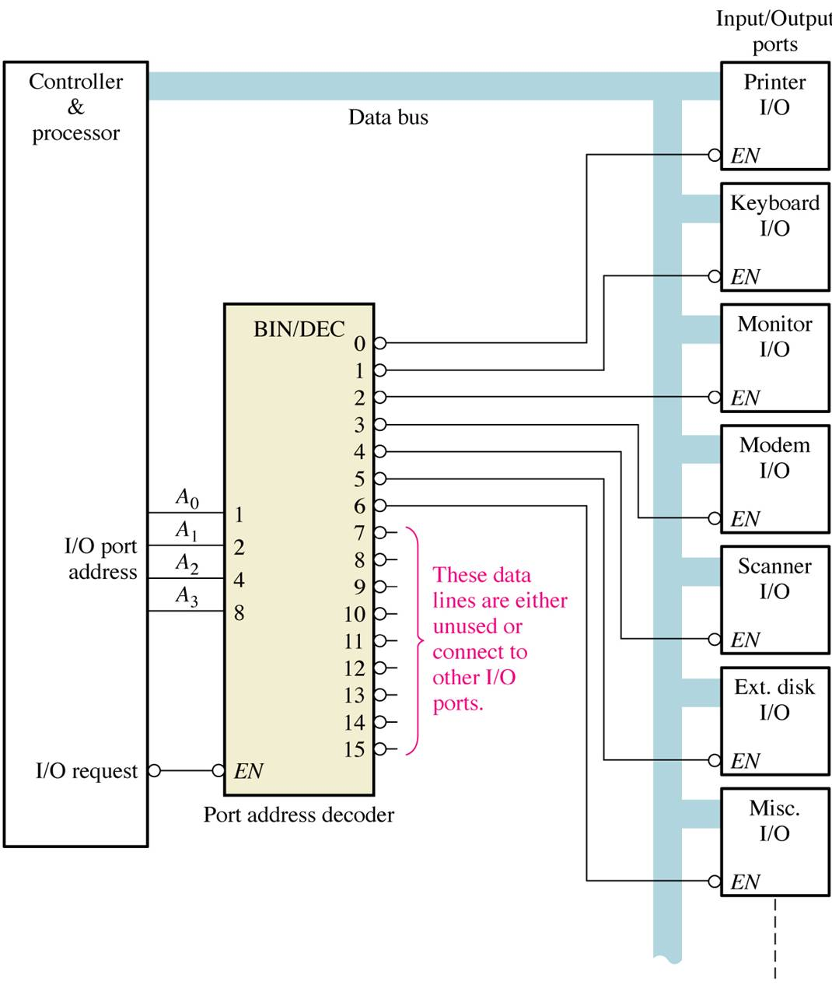
Application example
A simplified computer I/O port system with a port address decoder with only four address lines shown.

Slide 19
Decoder Applications
Decoders are used in many types of applications. One example is in computers for I/O selection as in previous slide.
Computer must communicate with a variety of external devices called peripherals by sending and/or receiving data through what is known as input/output (I/O) ports.
Each I/O port has a number, called an address, which uniquely identifies it. When the computer wants to communicate with a particular device, it issues the appropriate address code for the I/O port to which that particular device is connected. The binary port address is decoded and appropriate decoder output is activated to enable the I/O port
Binary data are transferred within the computer on a data bus, which is a set of parallel lines

Slide 20
BCD -to- Decimal decoders
The BCD- to-decimal decoder converts each BCD code into one of 10 position-able decimal digit indications. It is frequently referred as a 4-line -to- 10 line decoder
The method of implementation is that only ten decoding gates are required because the BCD code represents only the ten decimal digits 0 through 9.
Each of these decoding functions is implemented with NAND gates to provide active -LOW outputs. If an active HIGH output is required, AND gates are used for decoding

Slide 21
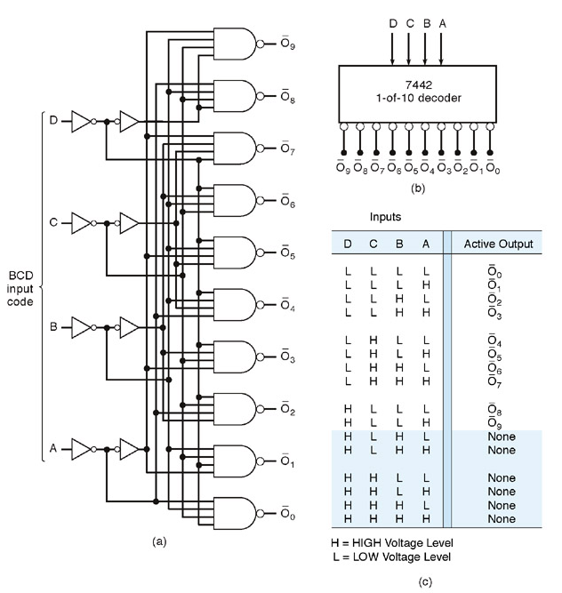
Logic diagram of BCD - decimal decoder
(Active LOW output)

Slide 22
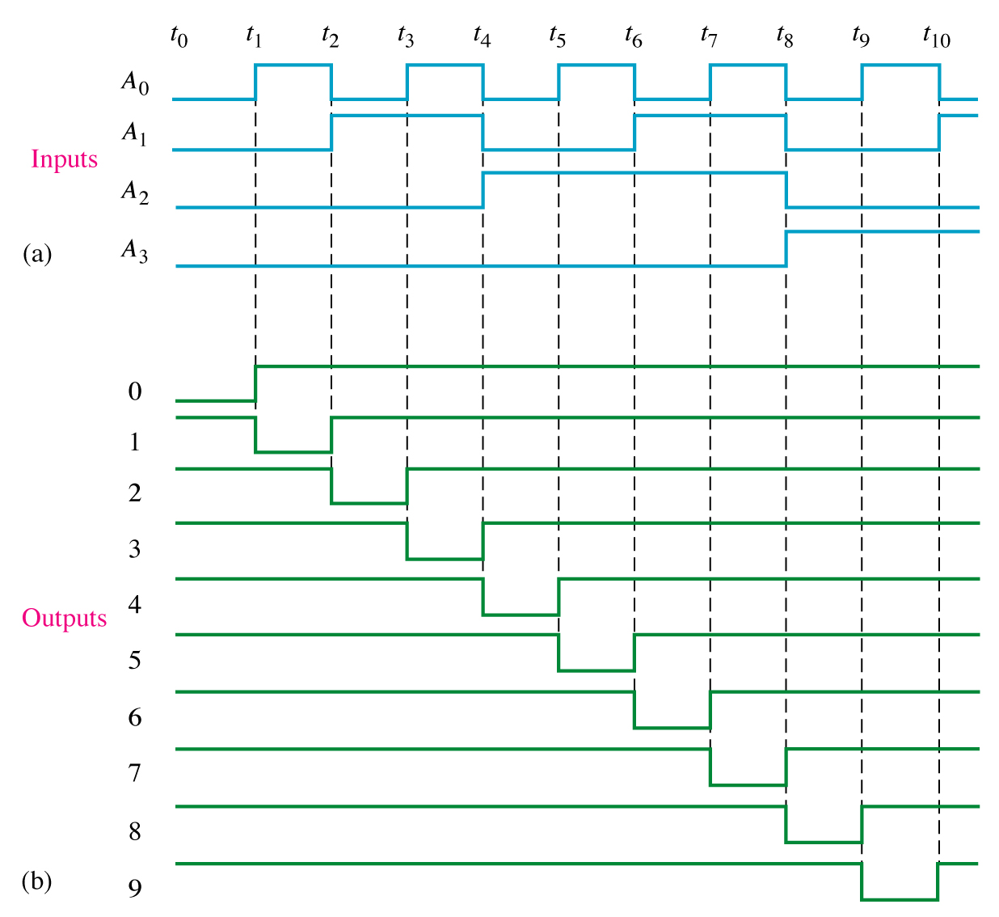
Output Waveform for BCD Decoder

Slide 23
Combinational Logic Circuit Implementation using a Decoder
Any combinational logic circuit with n inputs and m outputs can be implemented with an n-to-2n-line decoder and m OR gates.
Procedure:
  Express the given Boolean function in sum of min-terms
  Choose a decoder to generate all the min-terms of the input variables.
  Select the inputs to each OR gate from the decoder outputs according to the list of min-term for each function.

Slide 24
Encoder
Encoder is simply opposite of decoder

Slide 25
Encoder
An encoder is a combinational logic circuit that essentially performs a “reverse” of decoder functions.
An encoder accepts an active level on one of its inputs, representing digit, such as a decimal or octal digits, and converts it to a coded output such as BCD or binary.
Encoders can also be devised to encode various symbols and alphabetic characters.
The process of converting from familiar symbols or numbers to a coded format is called encoding.

Slide 26
Encoder vs Decoder
Most decoders accept an input code and produce a HIGH( or a LOW) at one and only one output line. In other words , a decoder identifies, recognizes, or detects a particular code. The opposite of this decoding process is called encoding and is performed by a logic circuit called an encoder.
An encoder has a number of input lines, only one of which input is activated at a given time and produces an N-bit output code, depending on which input is activated.

Slide 27
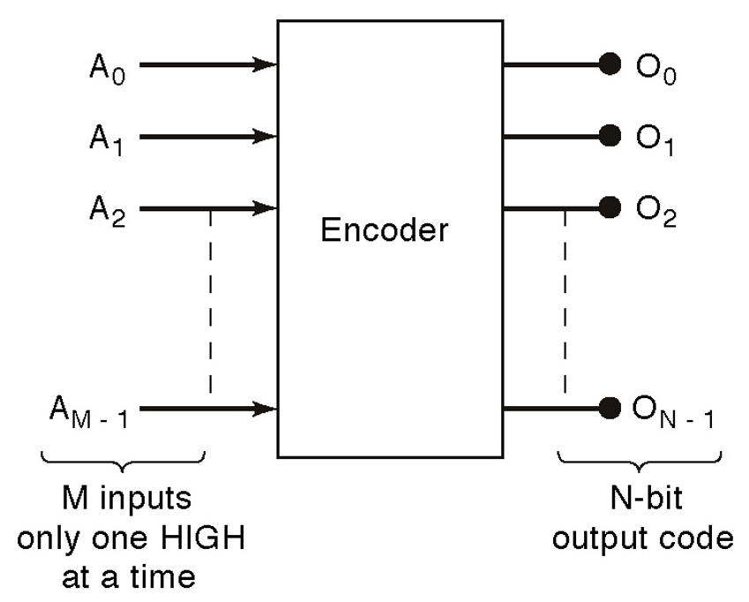
General Encoder Diagram

Slide 28
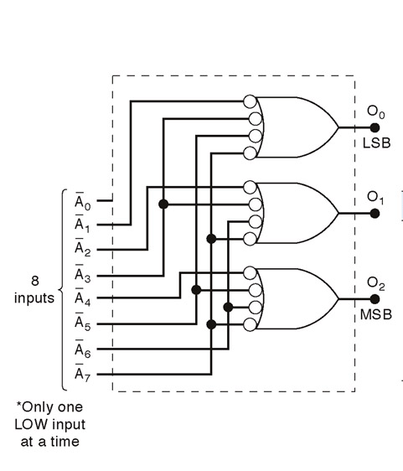
Logic Circuit for Octal-to Binary Encoder [8-line- 3-line ]

Slide 29
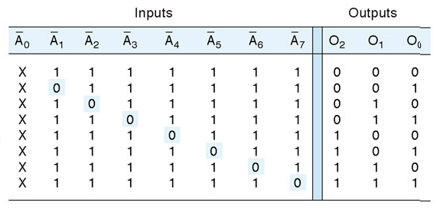
Truth Table for Octal-to Binary Encoder [8-line- 3-line ]
A low at any single input will produce the output binary code corresponding to that input. For instance , a low at A₃’ will produce O₂ =0, O₁=1 and O₀ =1, which is binary code for 3. A_{o}’ is not connected to the logic gates because the encoder outputs always be normally at 0000 when none of the inputs is LOW

Slide 30
Design of 4-input Priority Encoder
( 4-line-to 2 line priority encoder) (1)...
A priority encoder is an encoder that includes the priority function
If two or more inputs are active at the same time, the input having the highest priority will take precedence.
Truth Table of a 4-input priority encoder:
Inputs Outputs
D₀ D₁ D₂ D₃ X Y V
0 0 0 0 x x 0
1 0 0 0 0 0 1
X 1 0 0 0 1 1
X X 1 0 1 0 1
X X X 1 1 1 1

Slide 31
Design of 4-Input Priority Encoder
( 4-line-to 2 line priority encoder) (2)...
In addition to two outputs X, and Y, the truth table has a third output designated by V, which is a valid bit indicator that is set 1 when one or more inputs are equal to 1. If all inputs are 0, there is no valid input and V is equal to 0.
X’s in the output column indicate don’t care conditions, the X’s in the input columns are useful for representing a truth table in condensed form.
The higher the subscript number, the higher the priority of the input. Input D₃ has the highest priority, so regardless of the values of the other inputs, when this input is 1, the output for XY is 11 (binary 3)

Slide 32
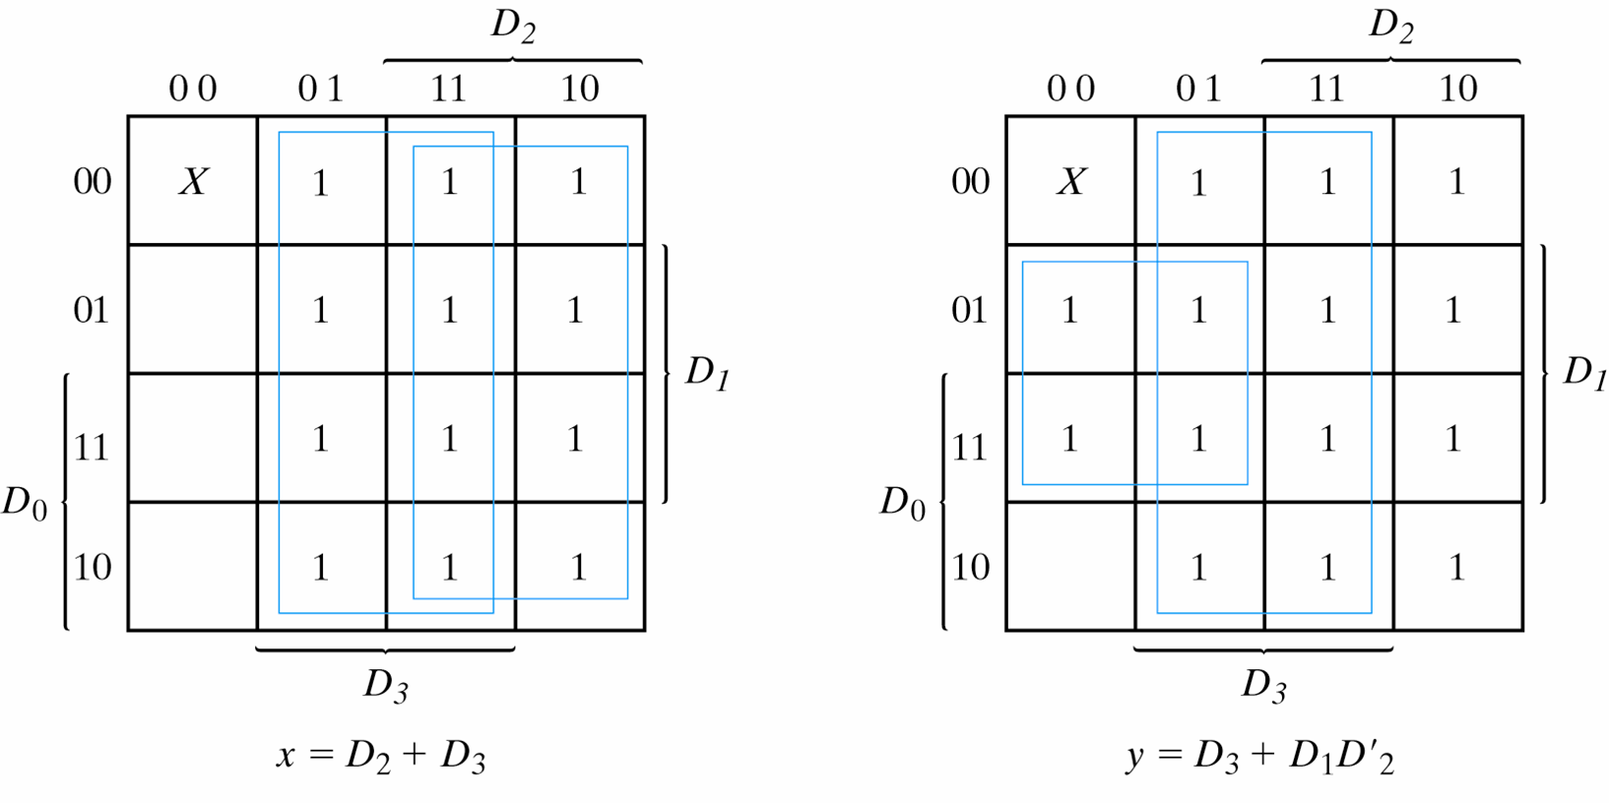
Design of 4-Input Priority Encoder
( 4-line-to 2 line priority encoder) (3)...
V=D₀+D₁+D₂+D₃
K-Maps for 4-input Priority Encoder

Slide 33
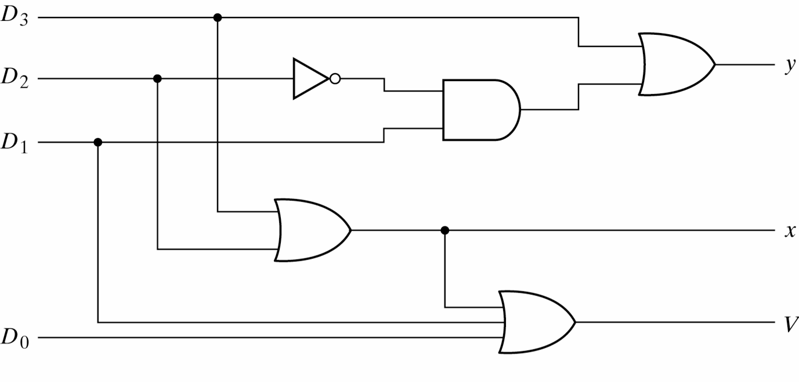
Design of 4-Input Priority Encoder
( 4-line-to 2 line priority encoder) (4)
Logic Diagram for 4-input priority encoder

